Slide 1




Deep Video Frame Interpolation using Cyclic Frame Generation
Yu-Lun Liu^{1,2,3} Yi-Tung Liao^{1,2} Yen-Yu Lin¹ Yung-Yu Chuang^{1,2}
¹Academia Sinica ²National Taiwan University ³MediaTek
Notes:
Hi everyone, I’m Yu-Lun Liu. It is my great honor to be here and introduce our paper “Deep Video Frame Interpolation using Cyclic Frame Generation.” This is a joint work with Yi-Tung Liao, Yen-Yu Lin and Yung-Yu Chuang

Slide 2
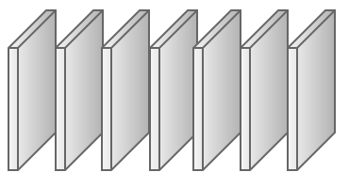
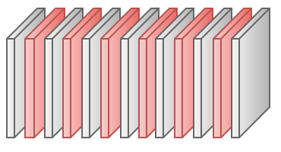



Video Frame Interpolation
Video interpolation produces videos of higher frame rates
It predicts the intermediate frame between two consecutive frames
Video 1x
Video 2x
?
Notes:
The goal of video frame interpolation is to increase the frame rates of videos.
It is often formulated to [CLICK] [CLICK] [CLICK] predict the intermediate frame between every two consecutive frames.

Slide 3
Why Video Interpolation
High-frame rate videos have temporally coherent content and smooth view transition
Acquiring such videos leads to higher power consumption and more storage requirement
Video interpolation compromises user experience and acquiring cost
Notes:
High-frame-rate videos with temporally coherent content are preferable, but acquiring such videos often requires higher power consumption and more storage.
To compromise between user experience and the acquiring cost, video frame interpolation has drawn increasing attention.
It aims at upscaling video frame rates by synthesizing spatially and temporally consistent intermediate frames.

Slide 4
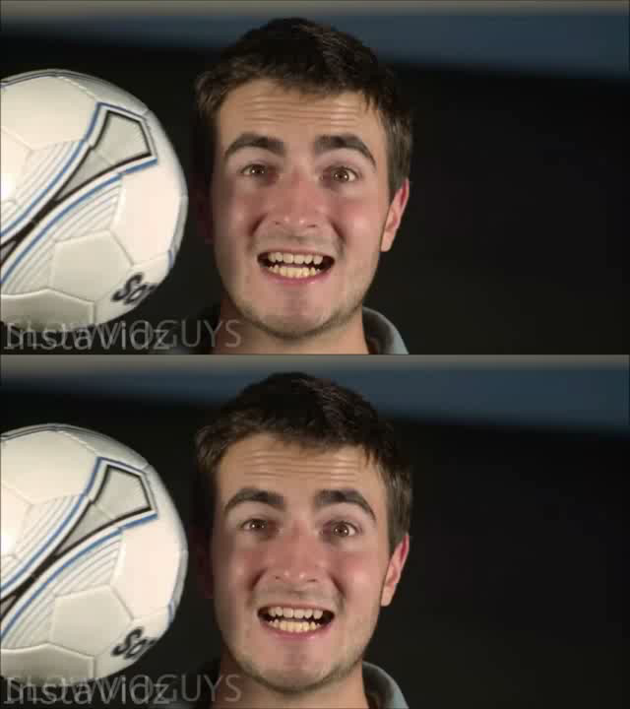
An Interpolated Video by Our Method
Original Video
8X Video
Video from “The Slow Mo Guys”:
https://www.youtube.com/watch?v=XjwO9InuFJk
Notes:
Let’s first take a look at an interpolated video by our method.
The top shows the original video, and the eight times interpolated video by our method is given in the bottom.
As can be seen, the interpolated video looks more temporally consistent.

Slide 5
Related Work
Video frame interpolation
Conventional (non deep learning based) methods
CNN-based methods
Predict the optical flow
Predict the intermediate frame
Notes:
The literature of video frame interpolation can be divided into conventional methods and CNN-based methods.

Slide 6
Related Work
Video frame interpolation
Conventional (non deep learning based) methods
Dense motion correspondences -> optical flow
Optimize complex objective function
✗ time-consuming
✗ computationally expensive
CNN-based methods
Predict the optical flow
Predict the intermediate frame
Notes:
Conventional methods usually rely on dense correspondences between consecutive frames via stereo matching or optical flow prediction.
Due to correspondence estimation, these methods are computation-intensive and less efficient.

Slide 7
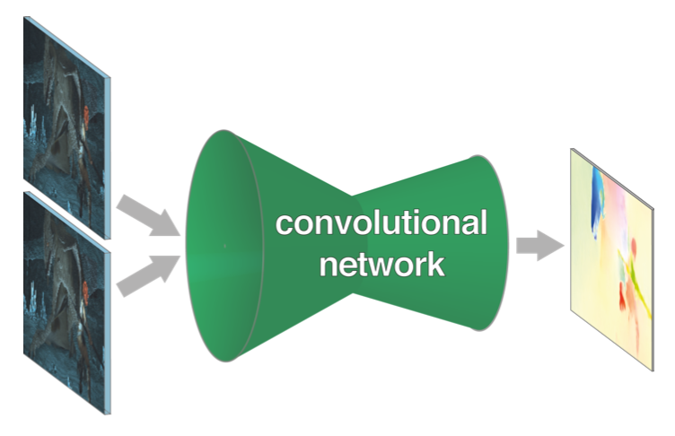
Related Work
Video frame interpolation
Conventional (non deep learning based) methods
CNN-based methods
Predict the optical flow based on FlowNet
✗ Hard to get the supervised data
Fischer et al. ICCV’15
Notes:
Some CNN-based methods for video frame interpolation rely on optical flow estimation such as using FlowNet.
However, these methods based on flow field prediction need training data in the form of dense correspondences, which are quite hard to annotate.

Slide 8
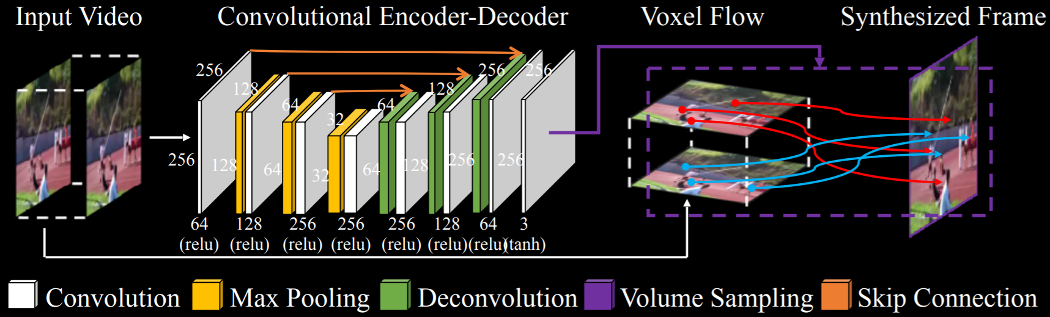
Related Work
Video frame interpolation
Conventional (non deep learning based) methods
CNN-based methods
Predict the intermediate frame, e.g., Deep Voxel Flow (DVF)
✓ No need for hand-crafted features
✓ More efficient and pleasing results
Liu et al. ICCV’17
Notes:
Some CNN-based methods directly estimate video frames, instead of dense correspondence.
Thus, they use ground-truth intermediate frames rather than dense correspondences.
However, these methods still suffer from blurred results and artifacts.
One recent method, called Deep Voxel Flow or DVF for short, addresses the problem of blurred results by referring to coherent regions and employing a network layer regarding optical flow.
DVF makes the synthesized frames sharper, but the problem of artifacts still remains.

Slide 9
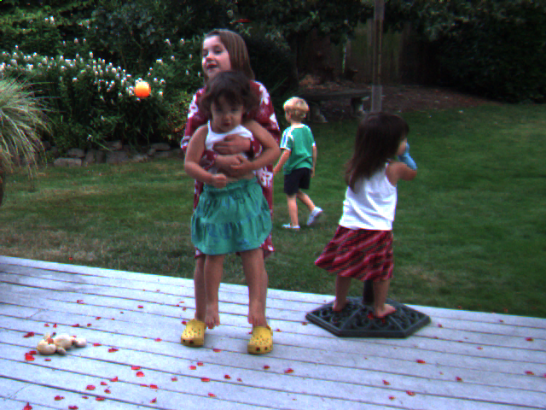
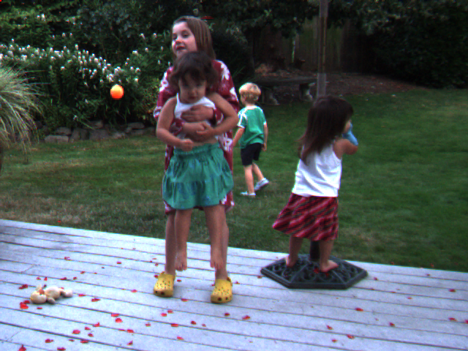

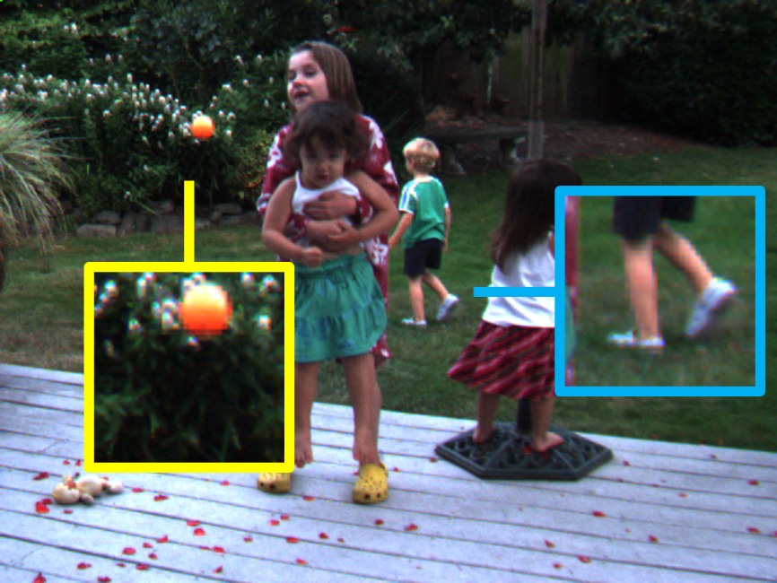
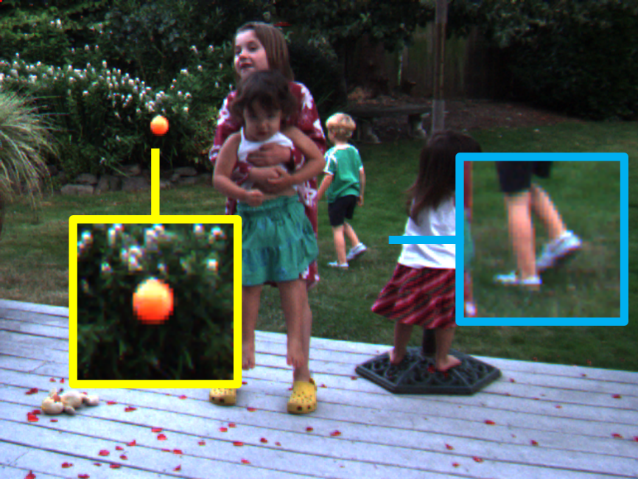
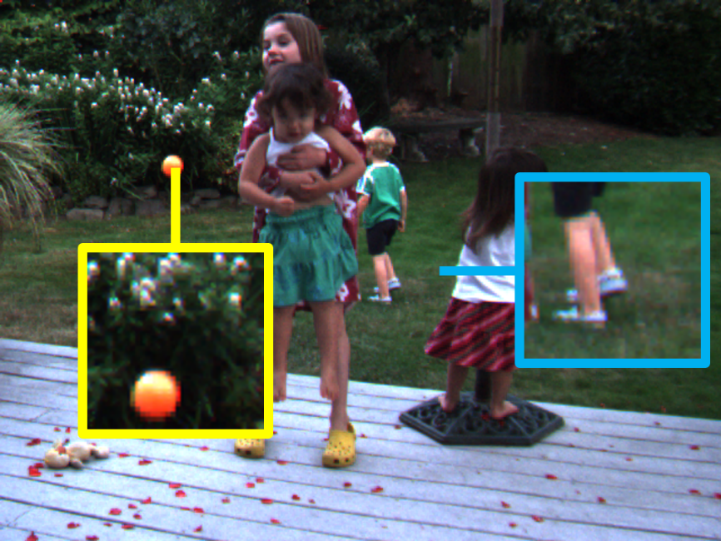



CNN-based Methods for Intermediate Frame Prediction
The problems: artifacts and over-smoothed results
$$I_{0}$$
$$I_{1}$$
$$I_{2}$$
Notes:
Here we show the examples of artifacts and over-smoothed results caused by CNN-based methods.

Slide 10
CNN-based Methods for Intermediate Frame Prediction
The problems: artifacts and over-smoothed results
$$I_{0}$$
$$I_{1}$$
$$I_{2}$$
Notes:
Given three consecutive frames, I0, I1, and I2

Slide 11


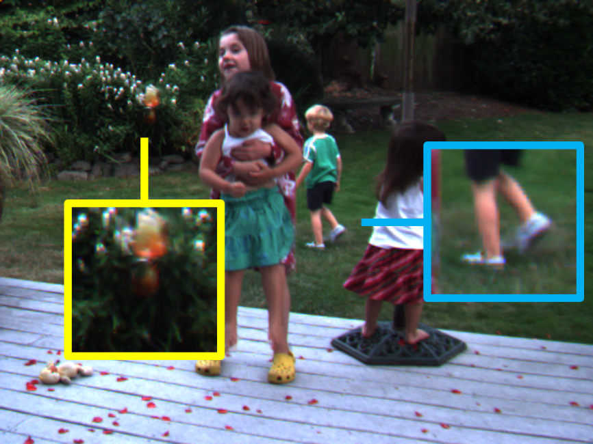
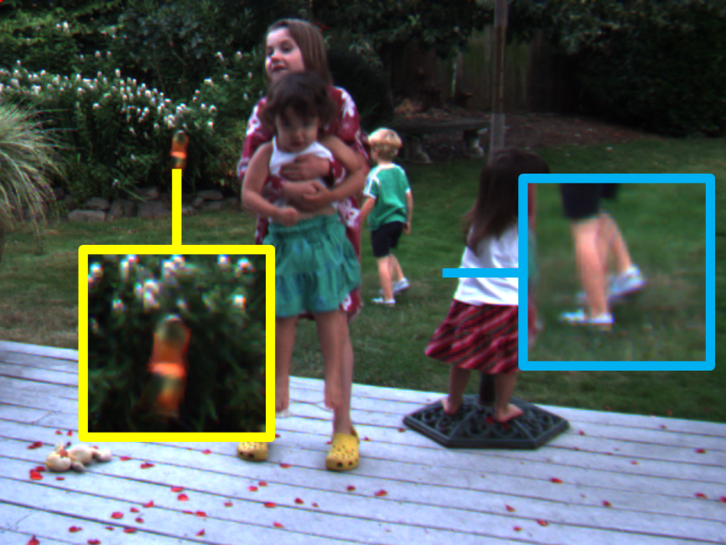


CNN-based Methods for Intermediate Frame Prediction
The problems: artifacts and over-smoothed results
$$I_{0}$$
$$I_{1}$$
$$I_{2}$$
$$I_{0.5}^{′}$$
$$I_{1.5}^{′}$$
Notes:
Here are the interpolated frames, I_0.5^’ and I_1.5^’, produced by the powerful CNN-based method DVF.

Slide 12
CNN-based Methods for Intermediate Frame Prediction
The problems: artifacts and over-smoothed results
$$I_{0}$$
$$I_{1}$$
$$I_{2}$$
$$I_{0.5}^{′}$$
$$I_{1.5}^{′}$$
Notes:
As shown in the yellow and blue boxes, the issues of artifacts and over-smoothed results are present in the interpolated frames

Slide 13
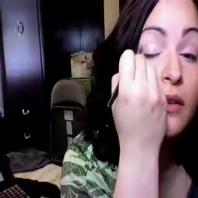
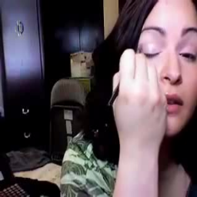
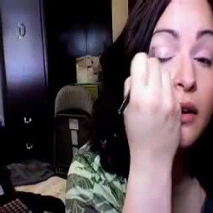



Our idea: Enforcing cycle consistency
Observation: Over-smoothed frames or frames with artifacts cannot well reconstruct the original frames
$$I_{0}$$
$$I_{0.5}^{′}$$
CNN
CNN
$$I_{1}$$
$$I_{1}^{′′}$$
CNN
$$I_{2}$$
$$I_{1.5}^{′}$$
Notes:
In the following, I give our solution to the two unfavorable issues.
Consider a model that generates the interpolated frame by taking two consecutive frames as inputs.
If the interpolated frames are oversmoothed or have artifacts, the reverse mapping is unlikely to be well performed by the same model.
Inspired by this observation, we implement forward-backward consistency by introducing the cycle consistency loss.
Specifically, the model maps the input frames to the interpolated frames, and then maps them back.
The cycle consistency loss enforces the similarity between the input frames and the mapped-back frames.

Slide 14
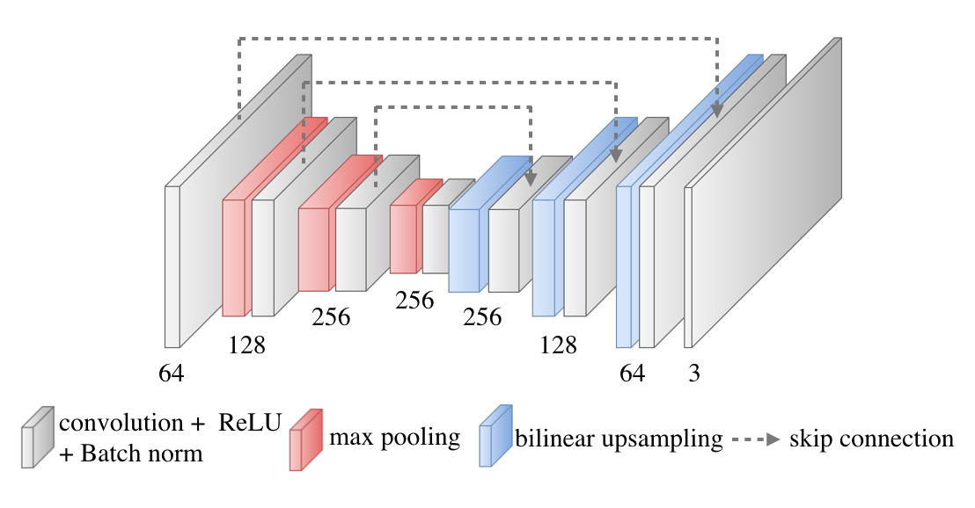
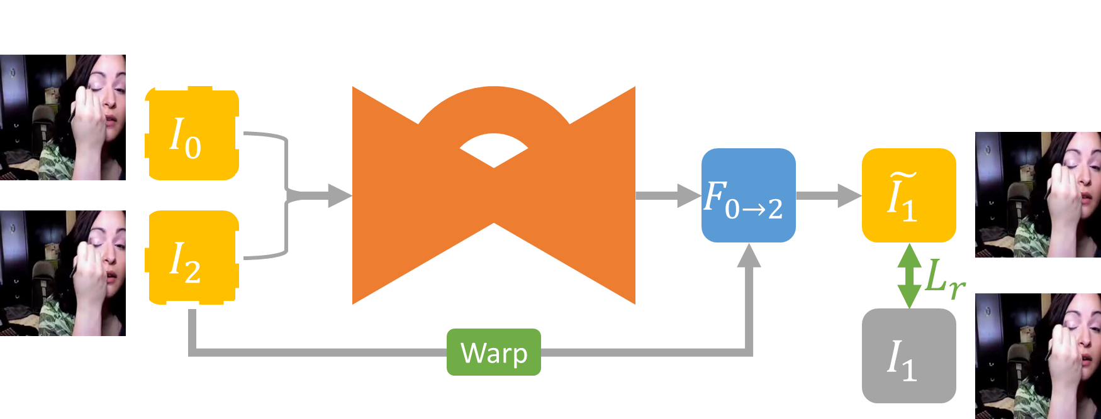

A two-stage training procedure
Our method is developed upon DVF [Liu et al. ICCV’17]
Stage 1: Pre-train the DVF
$$I_{1}^{′}$$
fully convolutional
encoder + decoder
skip connections
Notes:
Our method implements a two-stage training process.
Our network is built on the top of DVF.
At the first stage, DVF is pre-trained in the way developed in the original paper.

Slide 15


A two-stage training procedure
Stage 2: Include the cycle consistency loss
Duplicate the learned DVF three times
Compute the reconstruction error for cycle consistence checking
Fine-tune all DVF models
$$I_{1}^{′}$$
$$I_{1}^{′}$$
$$I_{1}^{′}$$
Notes:
At the second stage, we duplicate the pre-trained model three times for introducing the cycle consistency loss.

Slide 16
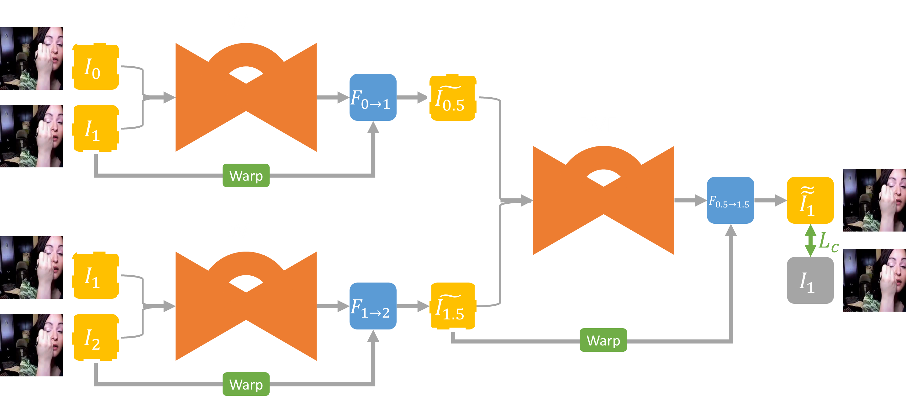
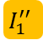
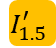
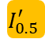
A two-stage training procedure
Stage 2: Include the cycle consistency loss
Duplicate the learned DVF three times
Compute the reconstruction error for cycle consistence checking
Fine-tune all DVF models
$$I_{0.5}^{′}$$
$$I_{1}^{′′}$$
$$I_{1.5}^{′}$$
Notes:
For a triplet (I0; I1; I2), the first two duplicated models respectively take (I0; I1) and (I1; I2) as inputs, and generate intermediate frames, I0.5’and I1.5’, which then serve as the input to the third duplicated model to produce the reconstructed I1, namely I1’’.
The cycle consistency loss minimizes the difference between the input frames I1 and its reconstructed version I1’’.
The learnable parameters of the baseline model and its three duplicated counterparts are shared.
At the second stage, the four shared-weight models are trained in an end-to-end manner.

Slide 17
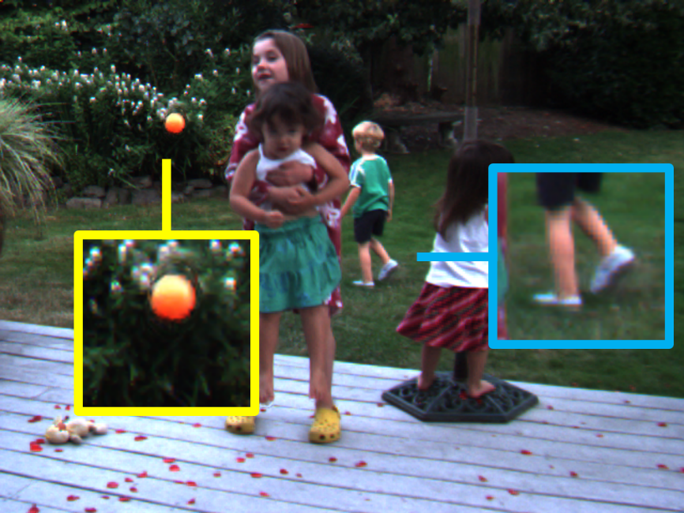
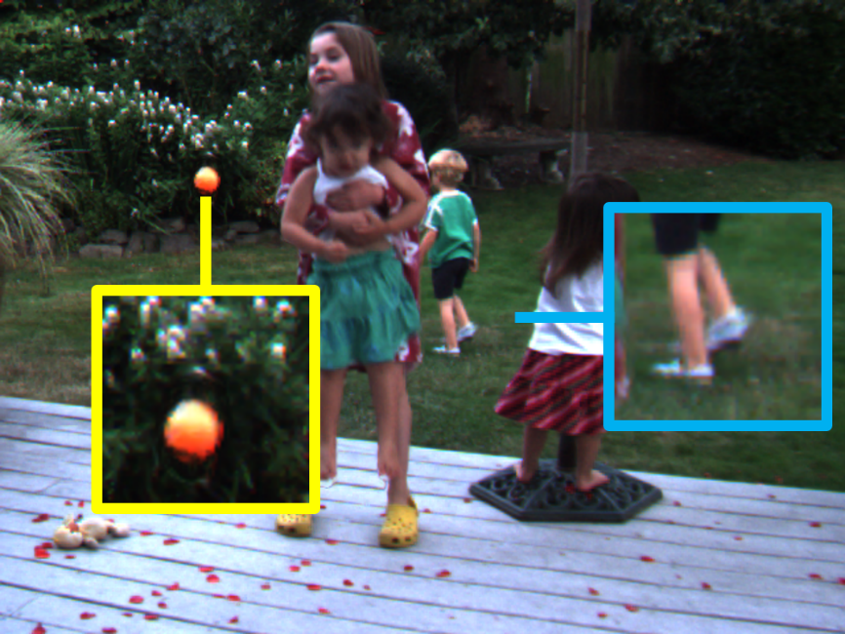







Input
$$I_{0}$$
$$I_{1}$$
$$I_{2}$$
DVF
$$I_{0.5}^{′}$$
$$I_{1.5}^{′}$$
DVF + Cycle loss
$$I_{0.5}^{′}$$
$$I_{1.5}^{′}$$
Notes:
With cycle consistency loss, the issues of artifacts and over-smoothed results are greatly alleviated.

Slide 18
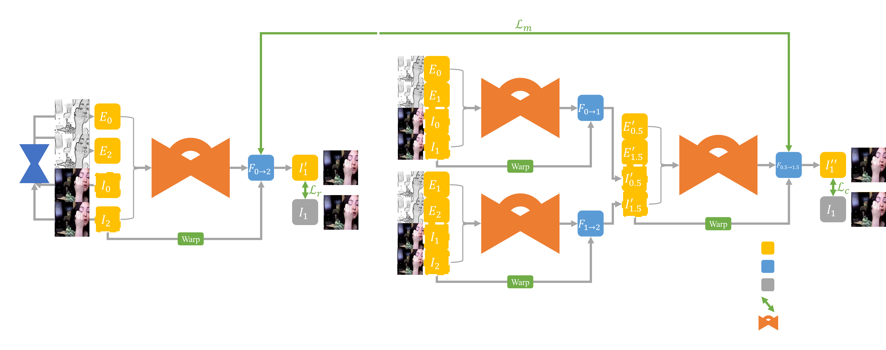

Network architecture
Motion linearity loss: Assume that the interval between two frames is short enough so that the motion between them is linear
$$ℒ_{m}=\sum_{n=1}^{N}{{\left\|F_{n, 0→2}−2∙F_{n, 0.5→1.5}\right\|}_{2}^{2}}$$
Notes:
Except for cycle consistency loss, we in this work introduce two components to enhance video frame interpolation.
(click)
The first one is motion linearity loss.
We assume the time interval between two consecutive frames is short enough so that the motion is linear between the two frames.
This assumption helps reduce the uncertainty of motion and alleviates approximation errors in most cases.
With the motion linearity assumption, the model pre-trained at the first stage generates flow fields with magnitudes twice as large as the duplicated models at the second stage.

Slide 19
Network architecture
Edge-guided training: Interpolation on highly textured regions is difficult. Hence, the edge maps are added to the input for edge preserving.
Notes:
The second component is edge-guided training
(click)
Interpolation on highly textured regions is difficult, so we add the edge information to the model input, and can improve frame interpolation by preserving the edge structure.
We use the CNN-based model, holistically-nested edge detection, to compute the edge maps to enrich the input to the network.

Slide 20
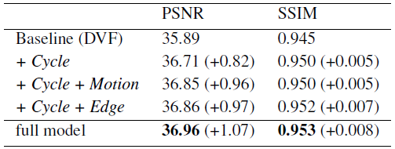
Experimental results: Ablation studies on UCF dataset
The introduced components, cycle consistency loss (Cycle), motion linearity loss (Motion), and edge-guided training (Edge), help video interpolation!
Notes:
To evaluate the proposed components, we conduct ablation studies on the UCF101 testing set provided by DVF.
The results indicate that the cycle consistency loss significantly improves the interpolation results by 0.82dB in PSNR.
The motion linearity loss and edge guided training further bring performance gains of 0.14dB and 0.15dB, respectively.

Slide 21
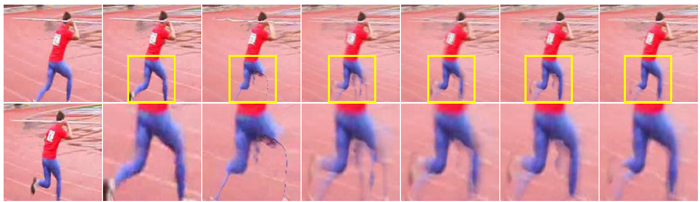
Experimental results: Ablation studies on UCF dataset
The introduced components, cycle consistency loss (Cycle), motion linearity loss (Motion), and edge-guided training (Edge), help video interpolation!
Input | (a) Ground truth | (b) Baseline (DVF) | (c) + Cycle | (d) + Cycle + Motion | (e) + Cycle + Edge | (f) Full model
Notes:
As shown in this challenging example, the synthesized frames have less visual artifacts and exhibit characteristics more similar to the original frames with the help of the introduced components.

Slide 22
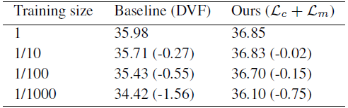
Experimental results: Ablation studies on UCF dataset
Cycle consistency loss improves the robustness to few training data
Notes:
Our cyclic frame generation method re-uses the generated frames as training data for the second-stage training. It can utilize the data more effectively.
We conduct experiments to verify the point by varying the amount of training data.
It is clear that our method with cycle consistency loss maintains performance better with less training data.

Slide 23
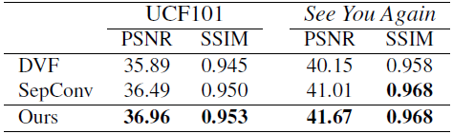
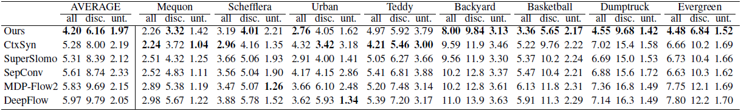
Experimental results: Comparison with SoTA
On the UCF-101 dataset and a high-quality video See You Again
On the Middlebury dataset
Notes:
On UCF101 and a high-quality YouTube video, See You Again, our method outperforms two state-of-the-art methods, DVF and SepConv.
On the Middlebury dataset, we fine-tune our model using the training set provided by Middlebury, which contains only 168 frames.
Our model achieves the best average performance and owns the best records for 5 out of all 8 sequences.
Fine-tuning with 168 frames also shows that our approach performs well with little training data.

Slide 24
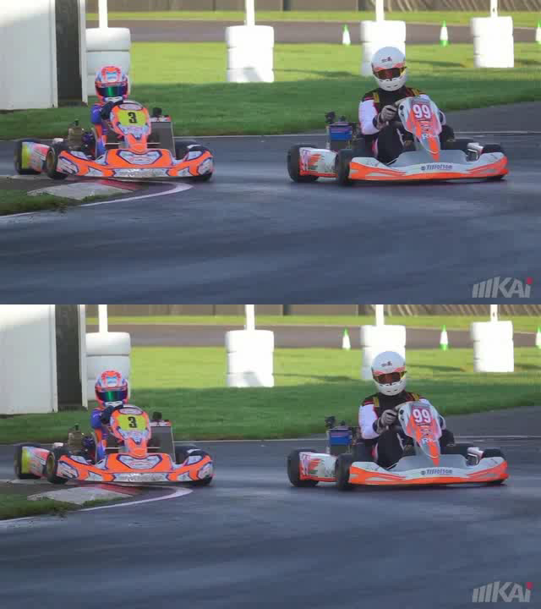
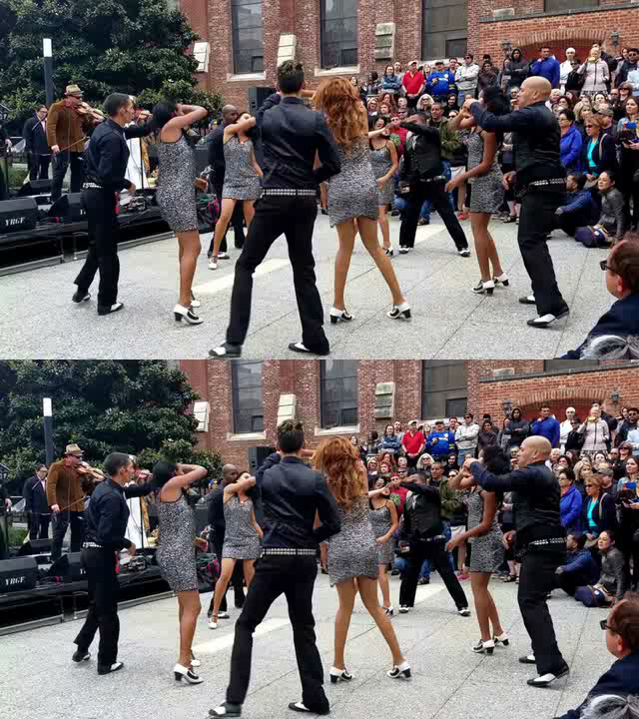
Experimental results: Demo videos
1X
8X
Notes:
Here are two videos interpolated by our method

Slide 25
Conclusions
We present a novel loss, cycle consistency loss, to
Be integrated into video frame interpolation and trained end-to-end
Synthesize more plausible frames possessing similar characteristics with the original frames
We make two extensions, motion linearity loss and edge guided training, to
Regularize the training procedure
Improve the performance
The proposed approach better utilizes the training data, not only enhancing the interpolation results, but also reaching better performance with less training data.
Notes:
Finally we conclude this work.
We present a novel loss, the cycle consistency loss, which can be integrated into existing video frame interpolation methods and trained in an end-to-end manner.
The resultant method synthesizes more plausible frames possessing similar characteristics with the original frames.
Additionally, we propose two extensions, motion linearity loss and edge guided training, to regularize the training procedure and further improve model performance.
The proposed approach better utilizes the training data, not only enhancing the interpolation results, but also reaching better performance with less training data.

Slide 26
Thank You for Listening!
Sour code available at https://github.com/alex04072000/CyclicGen
Yu-Lun Liu
Email: yulunliu@cmlab.csie.ntu.edu.tw
Notes:
Thank you for your attention.
We have released the source code at GitHub.
You are welcome to use our code.
Any feedback is appreciated.

